Slide 1
Virtual private cloud (vpc)
Velocity training institute
Shantanu Mahajan (sr engg devops)

Slide 2
VPC
VPC is nothing but a virtual private cloud.
It helps you to create a virtual isolated env in the same cloud.
Multiple virtual isolated Environments are also possible.
Amazon Virtual Private Cloud is a commercial cloud computing service that provides users a virtual private cloud, by "provision[ing] a logically isolated section of Amazon Web Services Cloud".
Amazon Virtual Private Cloud (VPC) gives you complete control over your virtual networking environment, including resource placement, connectivity, and security.

Slide 3
Why do we need vpc ?
You need a VPC: a virtual private network that keeps your servers safe from the ravages of the public internet.
Multiple Connectivity Options:-
Your AWS VPC can be connected to a variety of resources, such as the internet, your on-premise data center, other VPCs in your AWS account, or VPCs in other AWS accounts; once connected, you can make your resources accessible or inaccessible in your VPC from outside of your VPC based on your requirement.
Secure
Simple
All the scalability and reliability of AWS is available.

Slide 4
Use cases
Host a public facing website.
Host a multi-tier application, such as it will have web-layer, LB layer, DB layer etc.
Hosting of scalable web applications in your cloud.
Manage multiple projects, create isolated networks for those projects.

Slide 5
Some IMP terms
VPC:- this is nothing but a full isolated network.
Default VPC:- in every region there is a small default VPC created by amazon, this default VPC has all the standard routing rules set by amazon.
Non Default VPC
Subnets
Internet gateway
Network ACLs (Network Access Control List)
Security Groups
NAT Gateway/Instance.
Routing Tables.
IPs, DNS etc
VPC peering

Slide 6
Default limits
We can have only up to 5 non-default amazon VPC’s per region
You can create up to 200 subnets per VPC
We can create up to 200 network ACL per amazon VPC
We can have up to 5 Elastic IP addresses per AWS account per region.
Count of IPv4 CIDR blocks / VPC – 5
Count of IPv6 CIDR blocks / VPC – 1
Count of Internet gateways / Region – 5
Count of NAT gateways / Availability Zone - 5

Slide 7
subnets
A subnet, or subnetwork, is a network inside a network.
When we break down a network into smaller networks is called as subnet or subnetwork.
This breaking down of network is based on IP. (CIDR)
Basically there are 2 types of subnets
Public Subnet
Private Subnet

Slide 8
Route table
A route table contains a set of rules, called routes, that are used to determine where network traffic from your subnet or gateway is directed.
To put it simply, a route table tells network packets which way they need to go to get to their destination.
There are 2 types of routing Public routing and Private routing
Public routing is where we can route to the internet with the help of internet gateway.
Private routing means we can routing between private subnets or internal network only.

Slide 9
Internet gateway
An internet gateway is a horizontally scaled, redundant, and highly available VPC component that allows communication between your VPC and the internet.
If a VPC does not have an Internet Gateway, then the resources in the VPC cannot be accessed from the Internet.
A public subnet is a subnet that's associated with a route table that has a route to an internet gateway.
In simple terms this means, when a subnet is connected to internet its called as public subnet
An internet gateway has a Public IP attached to it.
There's no additional charge for having an internet gateway in your account.

Slide 10
NAT Gateway
NAT is nothing but network address translation.
This will translate your private IP to public IP so you can access internet from the private IP,
NAT gateway is usually created in public subnet with a public IP of its own.
Ideally the NAT gateway will sit in between your IGW and private subnet.
The NAT gateway will accept all the packets from private subnet and attach its own IP address to it and forward the packets to the IGW.
https://aws.amazon.com/vpc/pricing/

Slide 11
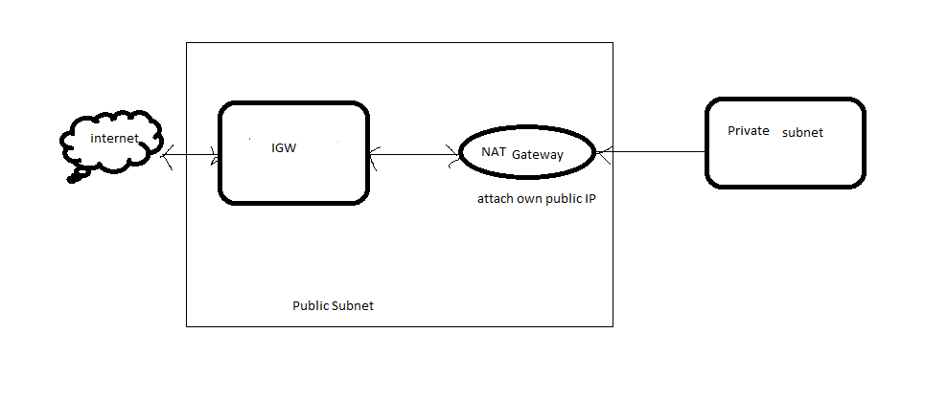

Slide 12
Nat gateway vs internet gateway
Internet Gateway (IGW) allows instances with public IPs to access the internet.
IGW allows resources within your public subnet to access the internet, and the internet to access said resources.
Two way communication
NAT Gateway (NGW) allows instances with no public IPs to access the internet.
It only works one way. Through NAT we can go from Private to Public but a public entity cannot access the private n/w.
One way communication
If we want 2 way NAT then we have to setup reverse NATing
In cloud computing we do not go for reverse NATing which is a standard

Slide 13
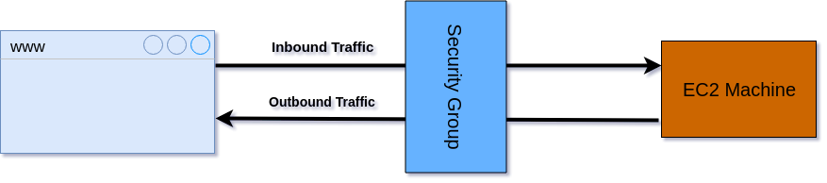
Security groups
A security group acts as a virtual firewall for your EC2 instances to control incoming and outgoing traffic.

Slide 14
Network ACL (access control list)
This acts as a firewall for associated subnets.
It controls both incoming and outgoing traffic at the subnet level.
It’s the 1st firewall at the network level.
A network access control list (ACL) is an layer of security for your VPC that acts as a firewall for controlling traffic in and out of one or more subnets.

Slide 15
NACL
A network access control list (ACL) is an optional layer of security for your VPC that acts as a firewall for controlling traffic in and out of one or more subnets.
The following are the parts of a network ACL rule:
Rule number. Rules are evaluated starting with the lowest numbered rule. As soon as a rule matches traffic, it's applied regardless of any higher-numbered rule that might contradict it.
Type. The type of traffic; for example, SSH. You can also specify all traffic or a custom range.
Protocol. You can specify any protocol that has a standard protocol number.
Port range. The listening port or port range for the traffic. For example, 80 for HTTP traffic.
Source. [Inbound rules only] The source of the traffic (CIDR range).
Destination. [Outbound rules only] The destination for the traffic (CIDR range).
Allow/Deny. Whether to allow or deny the specified traffic.

Slide 16
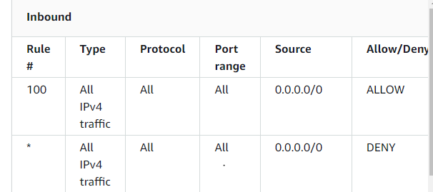
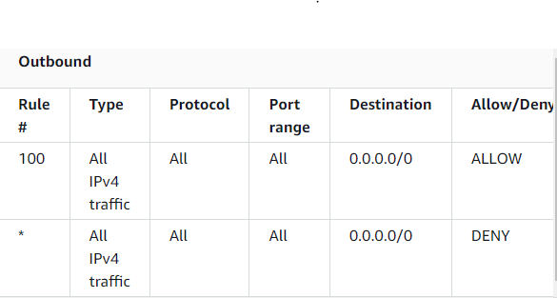
Default network ACL
The default network ACL is configured to allow all traffic to flow in and out of the subnets with which it is associated. Each network ACL also includes a rule whose rule number is an asterisk. This rule ensures that if a packet doesn't match any of the other numbered rules, it's denied. You can't modify or remove this rule.

Slide 17
SG VS Network ACL’s
Security Group
Network acl’s
Operates at instance level.
Supports only allow traffic.
Its stateful- return traffic is automatically allowed.
Evaluates all the rules before deciding whether to allow traffic or not.
Operates at subnet level.
Supports both allow and deny traffic.
Its stateless- return traffic must be explicitly allowed.
Its processes rules in numeric order when deciding whether to allow traffic or not.

Slide 18
Vpc peering
A VPC peering connection is a networking connection between two VPCs that enables you to route traffic between them using private IPv4 addresses or IPv6 addresses.
Instances in either VPC can communicate with each other as if they are within the same network. You can create a VPC peering connection between your own VPCs, or with a VPC in another AWS account.
The VPCs can be in different regions (also known as an inter-region VPC peering connection).

Slide 19
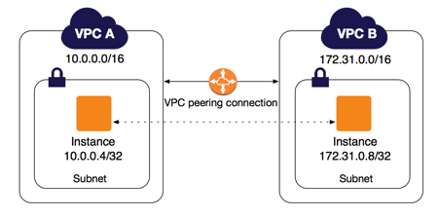
VPC Peering
AWS uses the existing infrastructure of a VPC to create a VPC peering connection; it is neither a gateway nor a VPN connection, and does not rely on a separate piece of physical hardware. There is no single point of failure for communication or a bandwidth bottleneck.

Slide 20
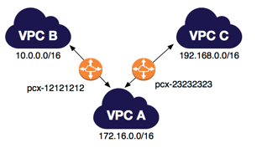
Multiple VPC peering connections
A VPC peering connection is a one to one relationship between two VPCs.
You can create multiple VPC peering connections for each VPC that you own, but transitive peering relationships are not supported.
You do not have any peering relationship with VPCs that your VPC is not directly peered with.

Slide 21
Some basics on the VPC connection
The owner of the requester VPC sends a request to the owner of the accepter VPC to create the VPC peering connection.
The accepter VPC can be owned by you, or another AWS account, and cannot have a CIDR block that overlaps with the requester VPC's CIDR block’s.
The owner of the accepter VPC accepts the VPC peering connection request to activate the VPC peering connection.
To enable the flow of traffic between the VPCs using private IP addresses, the owner of each VPC in the VPC peering connection must manually add a route to one or more of their VPC route tables that points to the IP address range of the other VPC (the peer VPC).

Slide 22
Pricing
If the VPCs in the VPC peering connection are within the same region, the charges for transferring data within the VPC peering connection are the same as the charges for transferring data across Availability Zones.
If the VPCs are in different regions, inter-region data transfer costs apply.
https://aws.amazon.com/ec2/pricing/on-demand/#Data_Transfer

